Slide 1
Youth Risk Statistics and Predictions
Phillip Nguyen
Tararath Chea
Brian Seto
Amy Li

Slide 2
Table of contents
Objective
Flowchart Processes
Data
Queries
Visualizations
Analysis Goal
Relevance to this class
Why we chose this data

Slide 3
Objectives
To be able to utilize the data for future reference. To be able to find the facts about this dataset and how it can relate to the real world regarding teenagers. To build descriptive visuals and being able to prescribe the data for better use. To help people in need of doing risky behaviors.

Slide 4
Flowchart Processes
Download data from https://chronicdata.cdc.gov/
Extract Dataset
Compile Data
List tables using SQL and export to create visual
Create table on beeline
Upload Load Data into server

Slide 5
Data
Youth risk dataset consists of topics of: Alcohol, drug, and Other health abuse. 2015-2017
Data Size: 5.75gb
Data Source URL: https://chronicdata.cdc.gov/views/q6p7-56au/rows.csv?accessType=DOWNLOAD

Slide 6
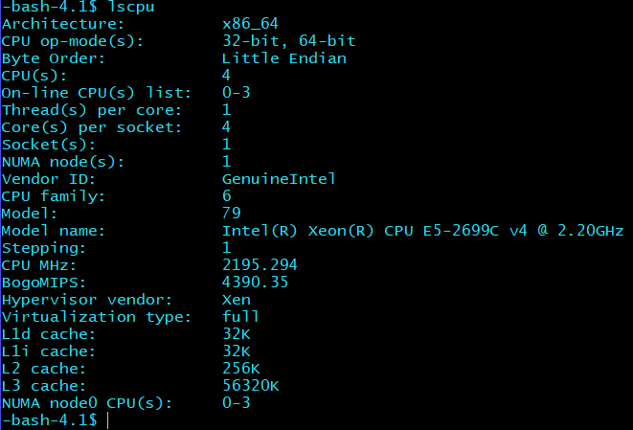

CPU SPEC
Oracle Big Data Compute Edition: 5 nodes
OCPUs: 10
Memory: 150 GB
Storage: 678 GB
HDFS Capacity: 147 GB

Slide 7

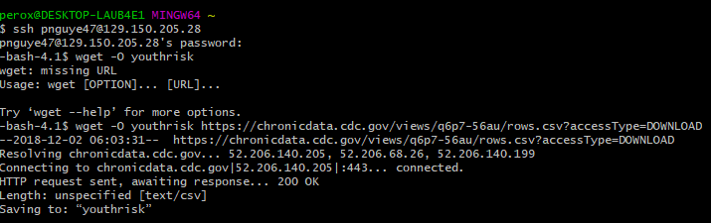
Input dataset into Hadoop system
Use assigned IP address:
$ ssh (username)@(ip-address)129.150.205.28
Use wget -o to download the files into the hadoop system
$ wget -o (naming-files) https://chronicdata.cdc.gov/views/q6p7-56au/rows.csv?accessType=DOWNLOAD

Slide 8
Make a directory to put the csv file into:
-bash-4.1$ hdfs dfs -mkdir youthrisk
-bash-4.1$ hdfs dfs -put youthrisk youthriskdata
Remove the file:
-bash-4.1$ rm youthriskdata
Connecting to Beeline:
beeline> !connect jdbc:hive2://cis4560-bdcsce-4.compute-608214094.oraclecloud.internal:2181,cis4560-bdcsce-2.compute-608214094.oraclecloud.internal:2181,cis4560-bdcsce-3.compute-608214094.oraclecloud.internal:2181/;serviceDiscoveryMode=zooKeeper;zooKeeperNamespace=hiveserver2?tez.queue.name=interactive bdcsce_admin

Slide 9
Table Creation
CREATE EXTERNAL TABLE IF NOT EXISTS risk_data(
YEAR INT, LocationAbbr STRING,
LocationDesc STRING,
DataSource STRING,
Topic STRING,
Subtopic STRING,
ShortQuestionText STRING,
Greater_Risk_Question STRING,
Description STRING,
Data_Value_Symbol INT,
Data_Value_Type STRING,
Greater_Risk_Data_Value INT,
Greater_Risk_Data_Value_Footnote_Symbol INT,
… … …

Slide 10
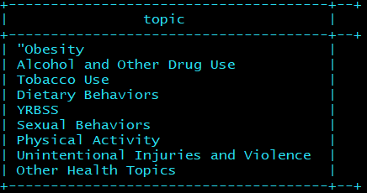
Sample Query Data
SELECT DISTINCT topic FROM risk_data;

Slide 11
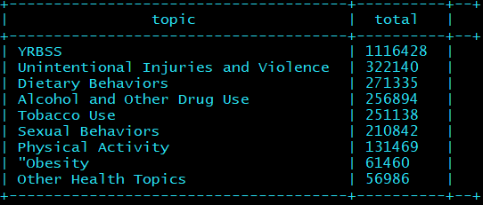
To determine how many risk based on topics are being used:
0: jdbc:hive2://cis4560-bdcsce-4.compute-6082> SELECT topic, COUNT(topic) as total from risk_data GROUP BY topic ORDER BY total DESC limit 20;

Slide 12
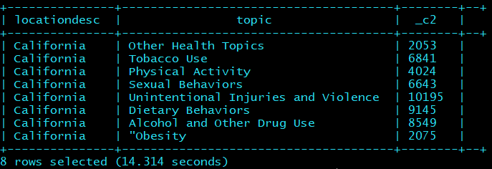
Data From California

Slide 13
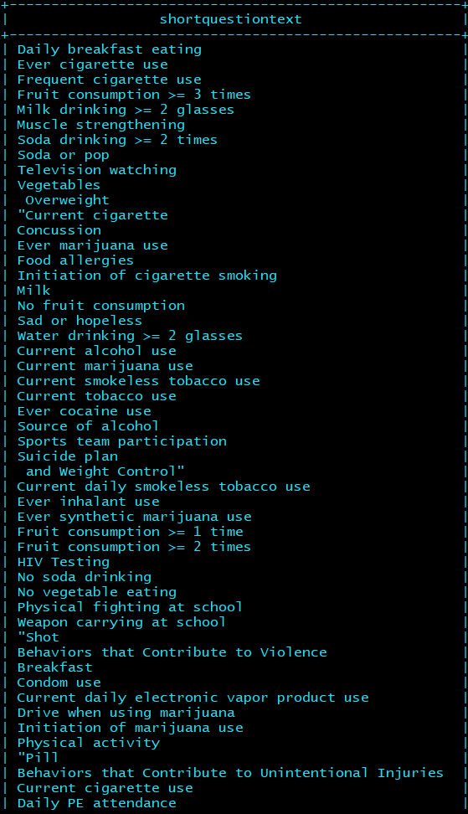
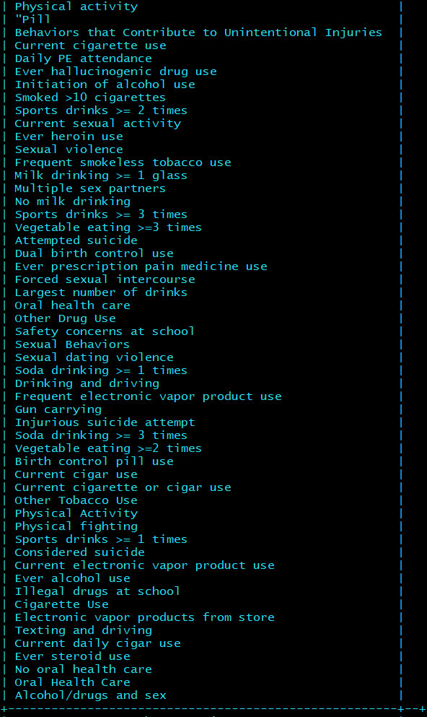
Type of questions on the survey
select distinct shortquestiontext from risk_data;

Slide 14
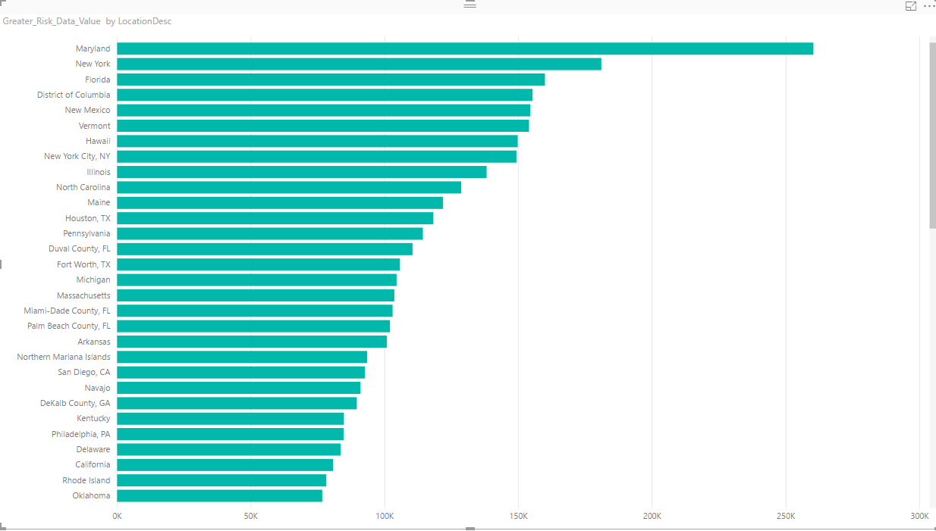
States Most & Least at Risk behaviors

Slide 15
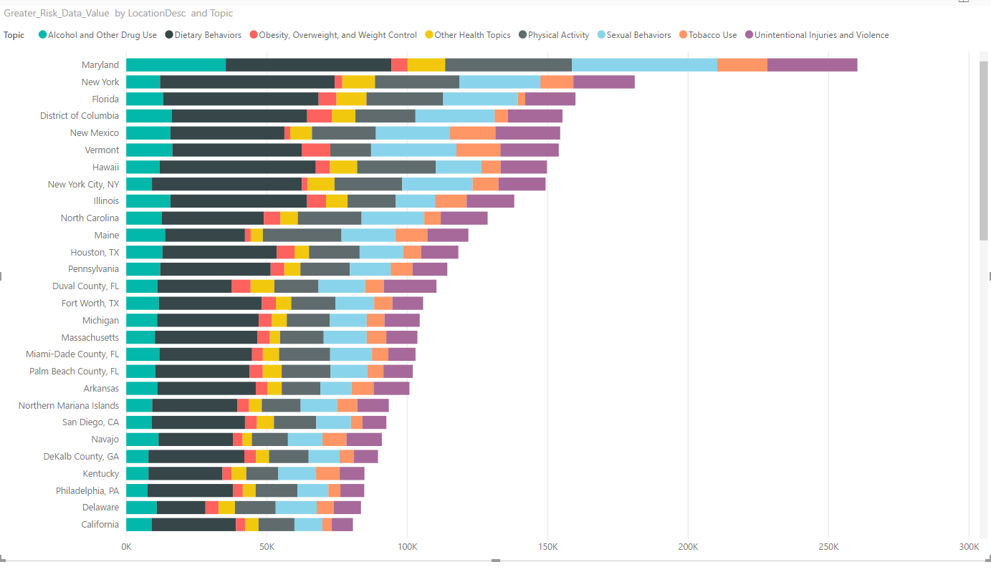
How many topics are covered in the risk data?

Slide 16
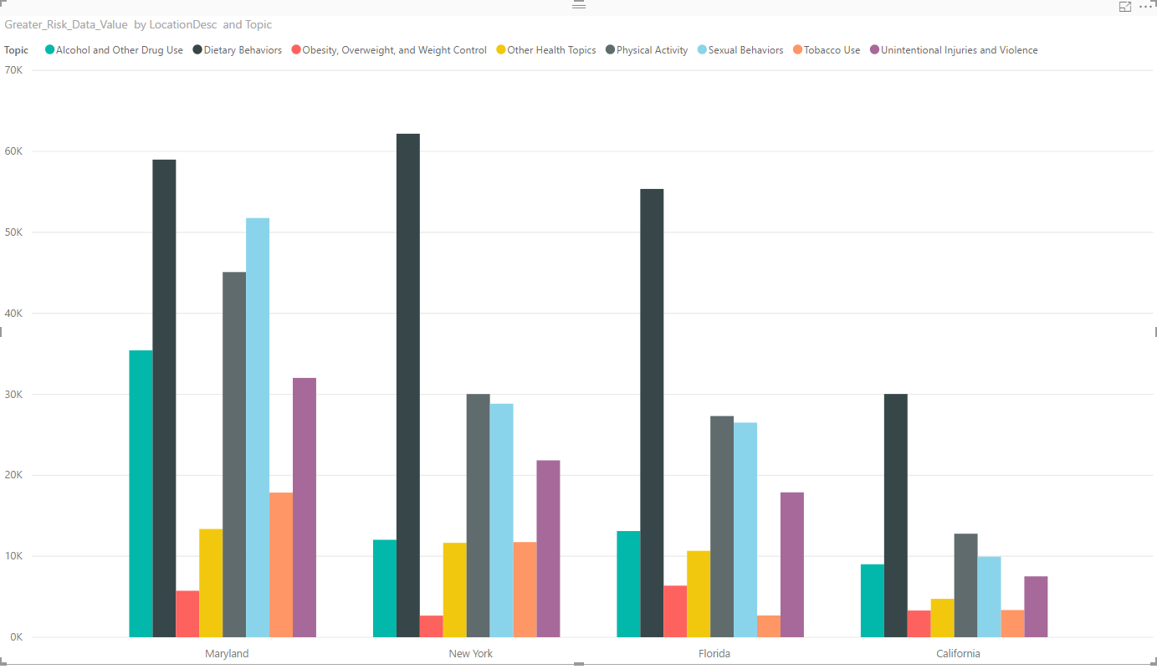
Compare Los Angeles,CA to the top 3 high risk states

Slide 17
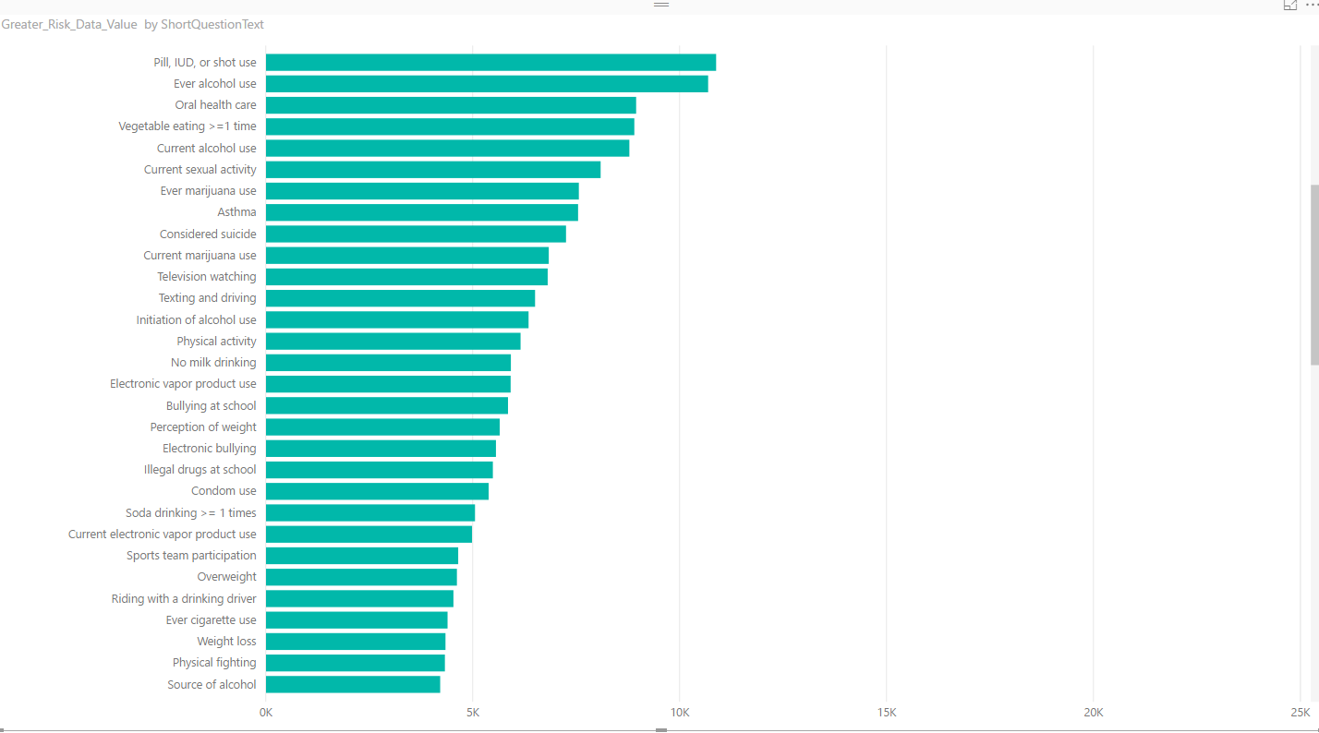
Things that can lead to these risk behaviors topics

Slide 18
Excel file gets corrupted
simple fix open excel go to file->options->add-ins->managed-> Go to dropdown box and check disabled items -> enable those youth risk files and load the dataset again.

Slide 19
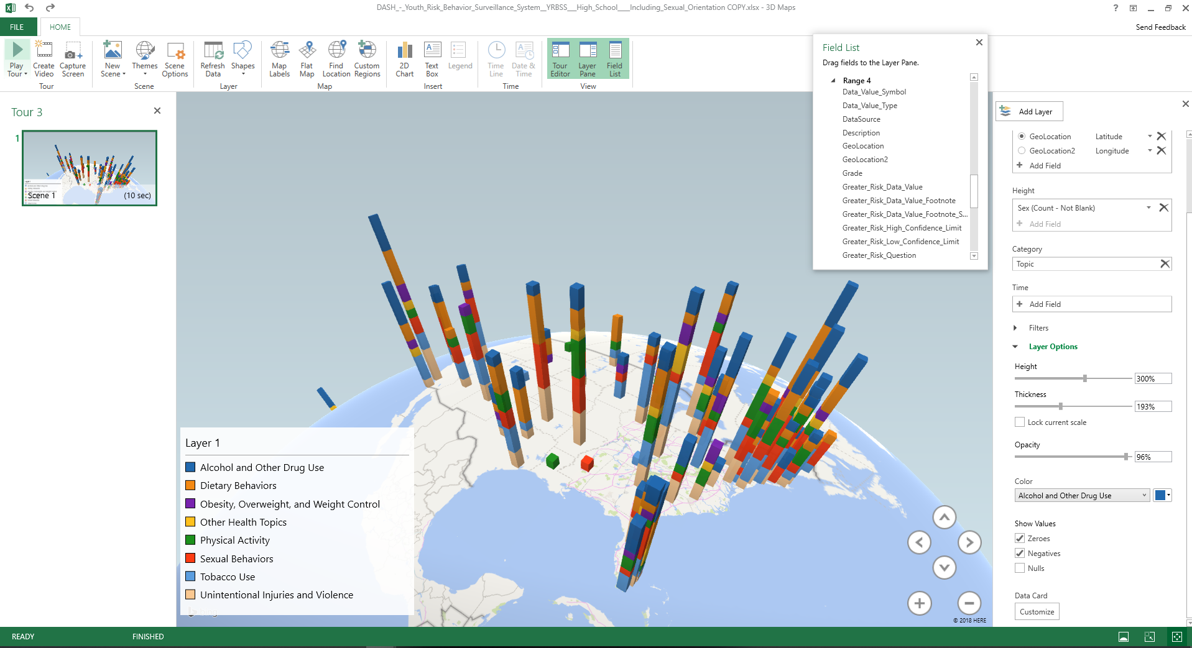
What can be learned from the data?

Slide 20
Analysis goals
Our goals is to help improve our community, by showing the statistics of youth risk at health abuse.

Slide 21
Relevance to class
Applying the programs we learned about in class to analyze data
Github Link:
https://github.com/tchea/CIS4560-YouthRisk

Slide 22
Problems Encountered
CSV file wasn’t completely open with Excel Sheet
Excel can only open up 1,048,576 rows by 16,384 columns
Data file was too big which resulted in missing data
When creating the table in Beeline, table name has to be exactly the same as the given file
Corrupted data
Notes:
Cant do anything about it so some data is

Slide 23
Why we chose this data
We chose this data because it talks about the behaviors that happen among the youth and young adults.
The main causes would be the violence, alcohol and drug use would lead to sexual behaviors that contribute to accidental pregnancy, and sexual transmitted diseases (STDs).
The parents need to be aware of what is happening to their kids and our data helps figure that out.

Slide 24


Slide 25


